Slide 1

ITI Examination System
Information Technology Institute

Slide 2
TABLE OF CONTENTS
01.
04.
02.
03.
07.
Introduction
Stored Procedures
Reports
05.
08.
Business Case & Project Steps
Data Warehouse
Website
06.
09.
Database Design
Dashboards
Exam Stored Procedures

Slide 3




Meet Our Team
Sandra Essa
Hala Farid
Nadda Khaled
Dalia Hosny

Slide 4
01.
Introduction

Slide 5

INTRODUCTION

Slide 6





INTRODUCTION

Slide 7
02. Business Case & Project Stages

Slide 8
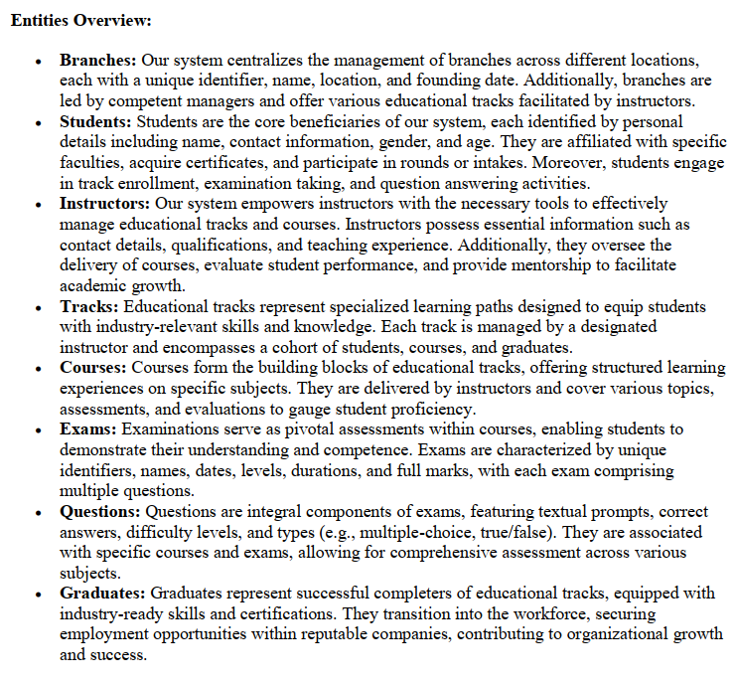

Business Case

Slide 9







Project Stages
Database Design
Reports &
Dashboard
1
Generate
Data
5
2
Documentation
4
6
3
7
Database Implementation
Data
Warehouse
Website

Slide 10
03.
Database Design

Slide 11
ERD

Slide 12
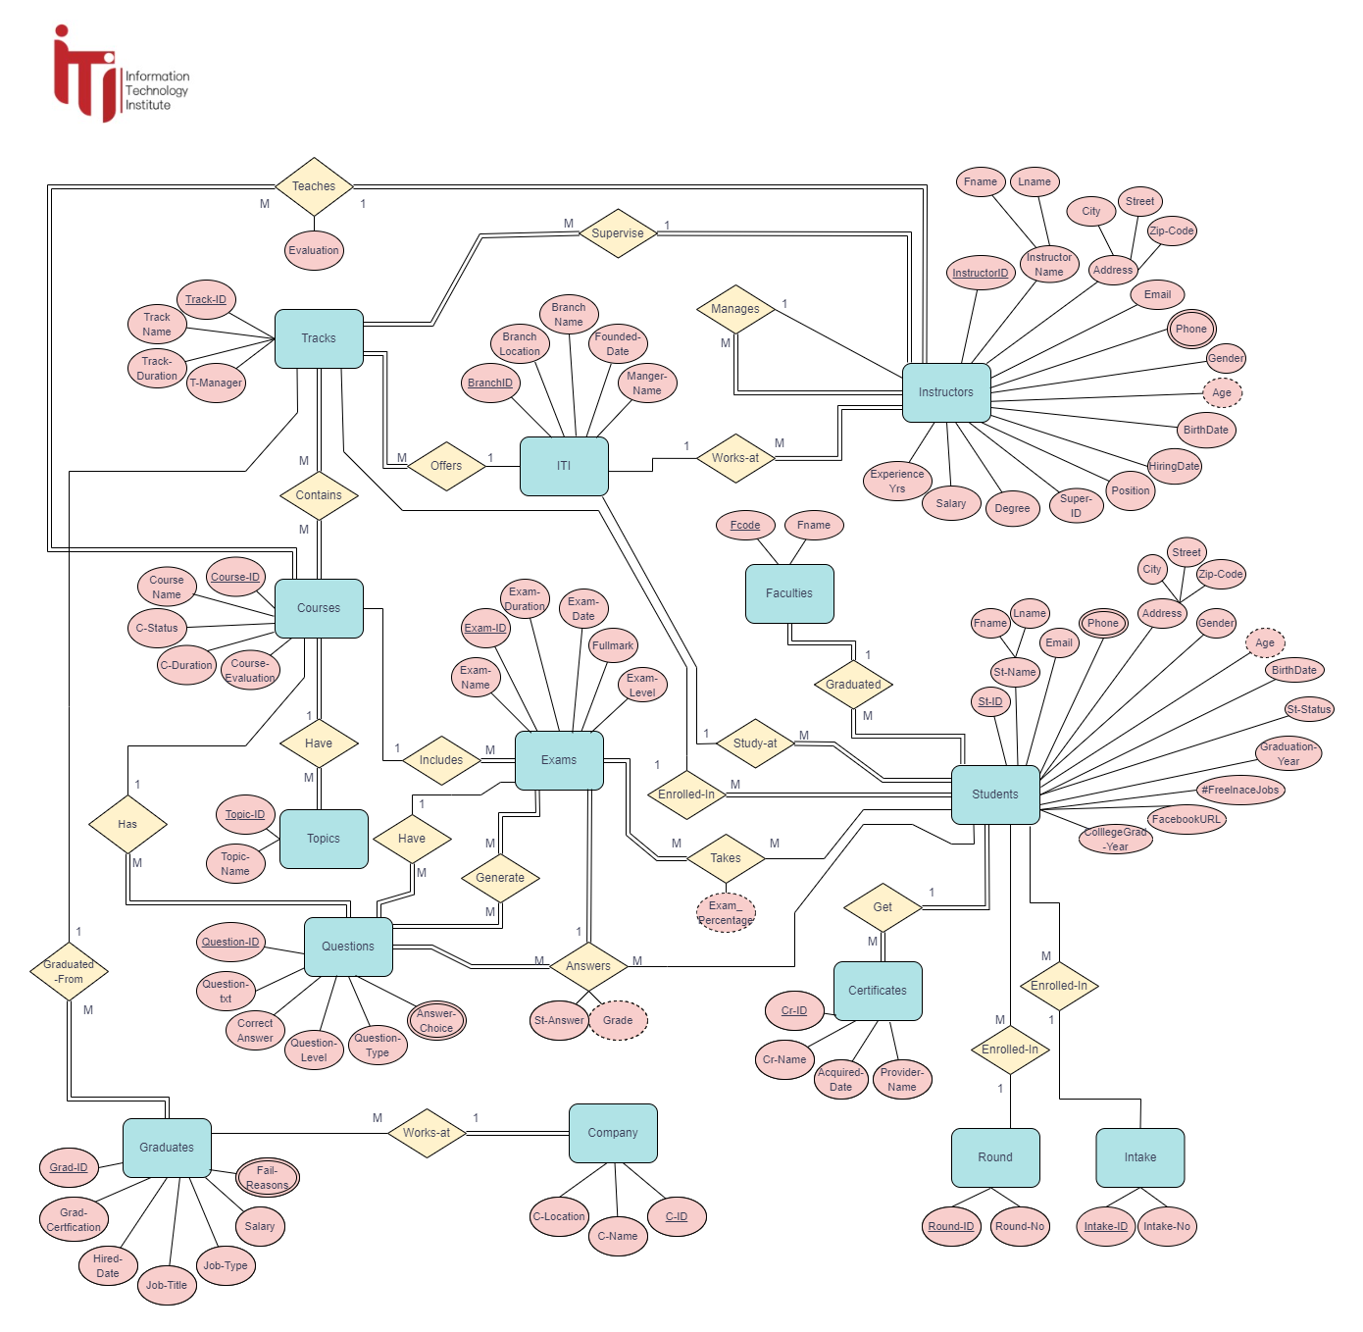

Slide 13
DB Schema

Slide 14
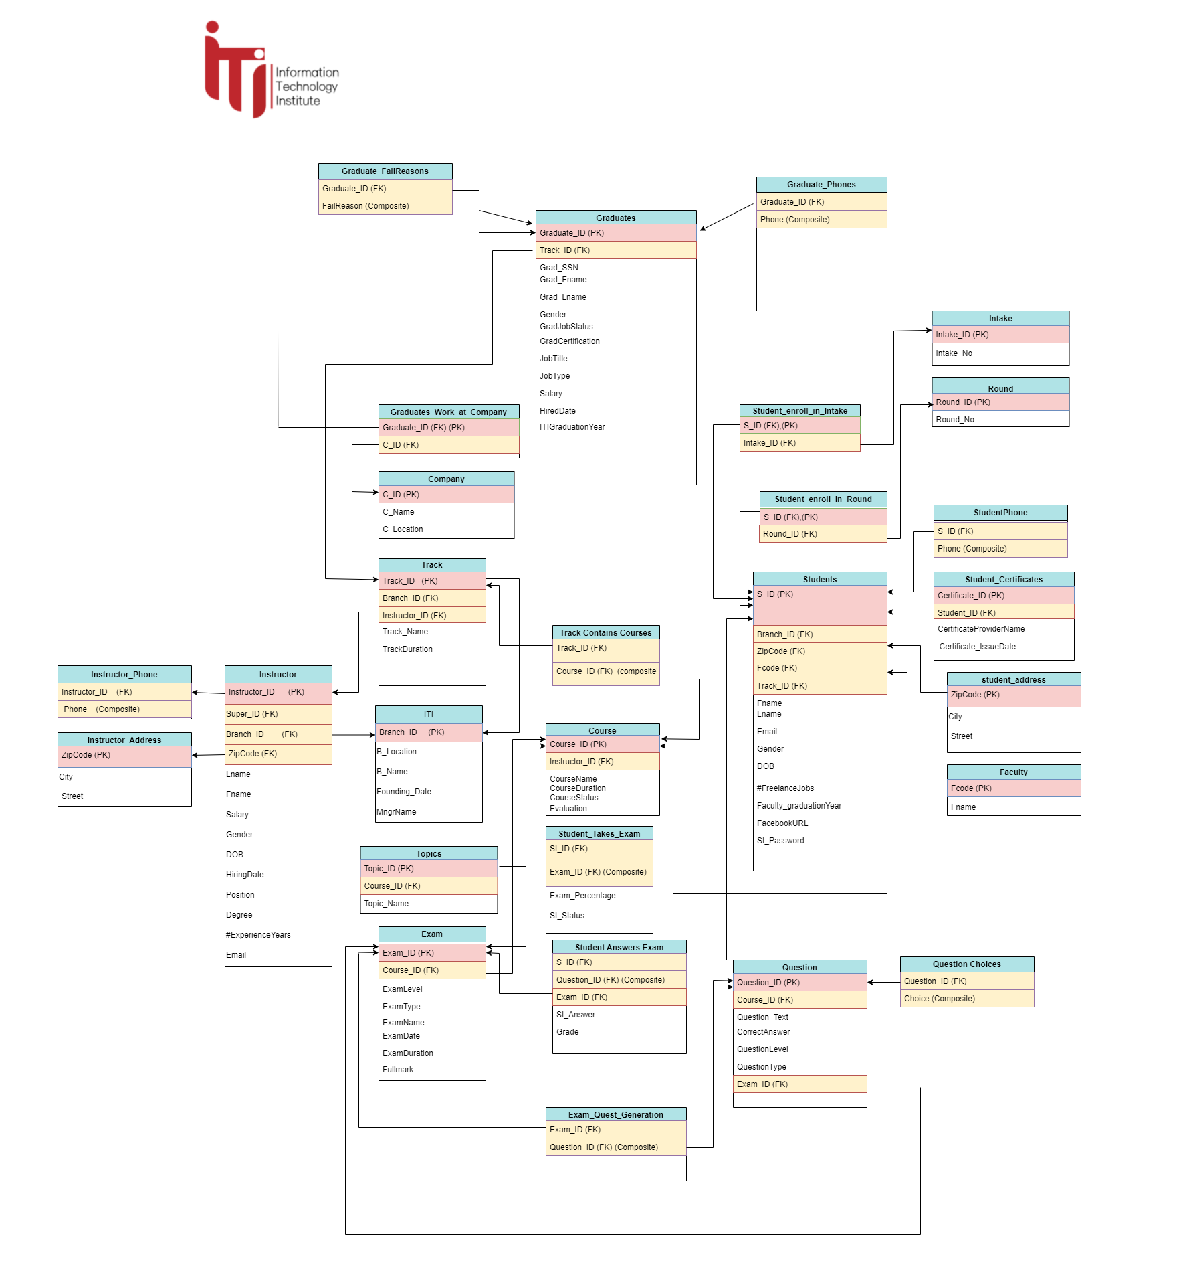

Slide 15
04.
Stored Procedures

Slide 16
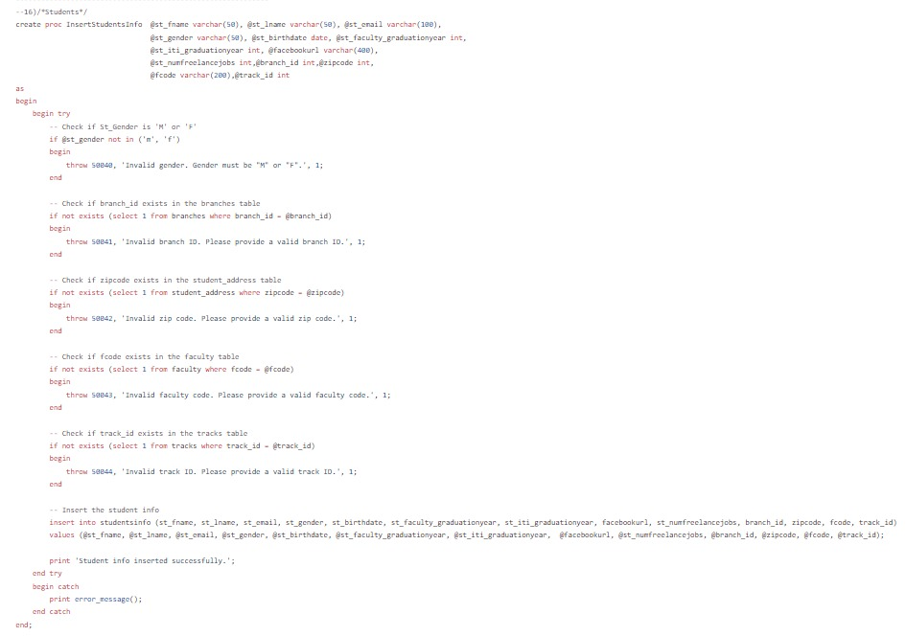
Insert StoredProcedure

Slide 17
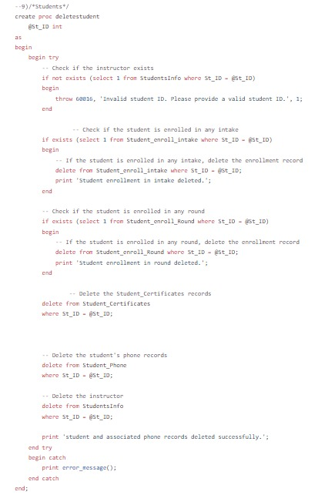
Delete StoredProcedure

Slide 18
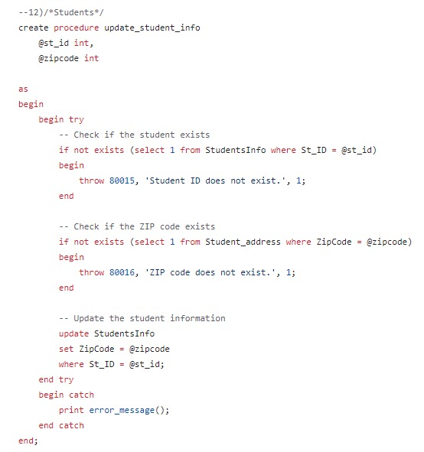
Update StoredProcedure

Slide 19
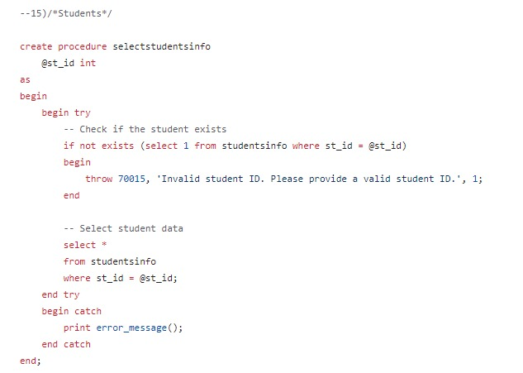
Select StoredProcedure

Slide 20
Exam Stored Procedures
05.

Slide 21
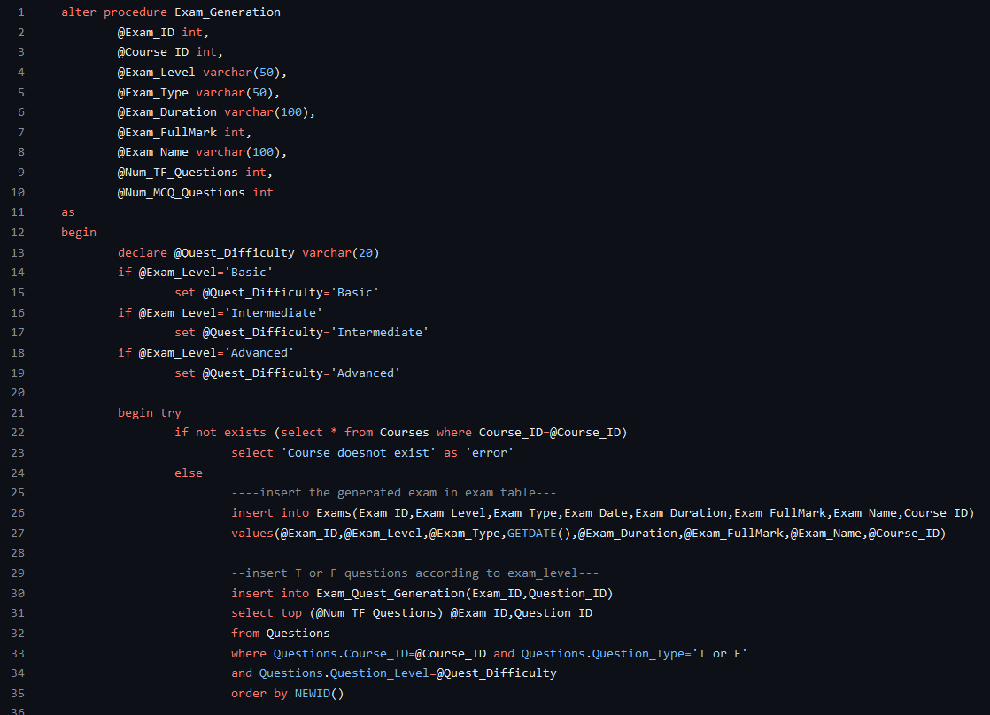
01.Exam Generation

Slide 22
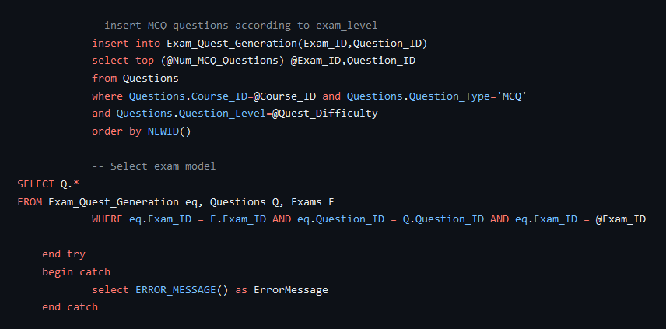
01.Exam Generation

Slide 23
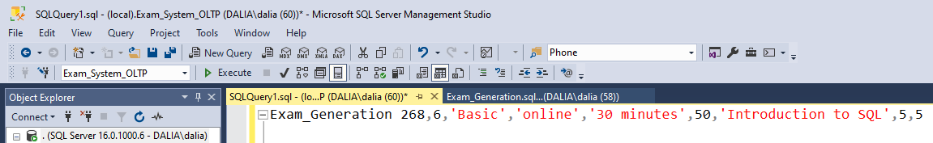
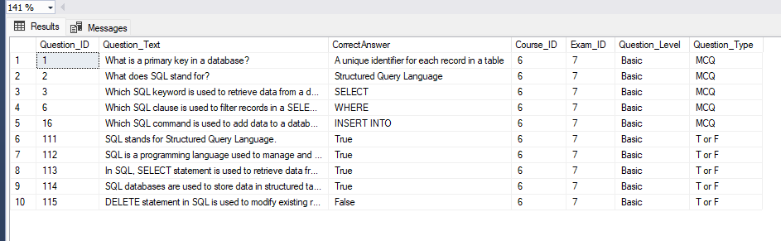
01.Exam Generation

Slide 24
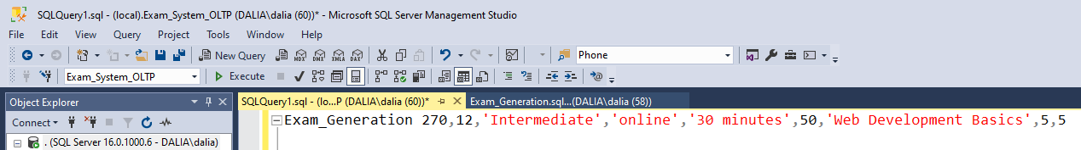
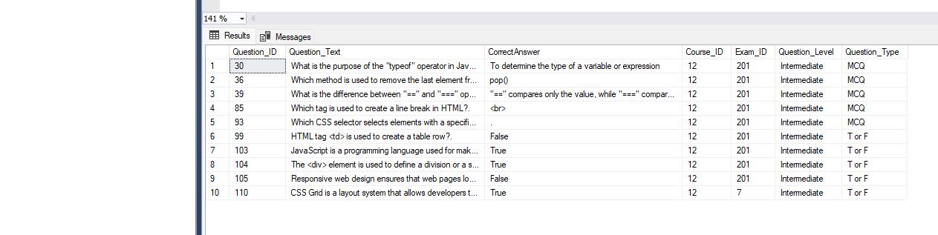
01.Exam Generation

Slide 25
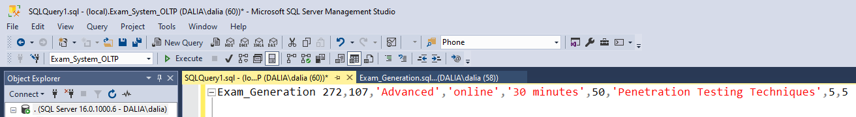
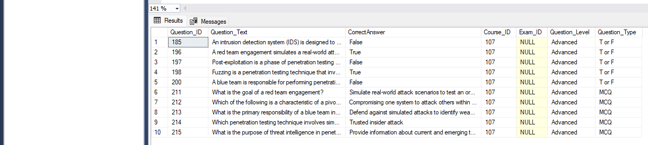
01.Exam Generation

Slide 26
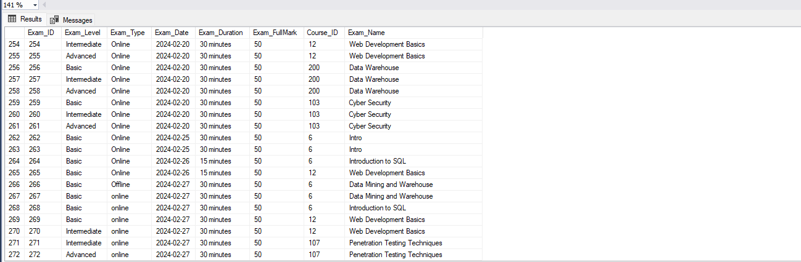
01.Exam Generation
Table Exams

Slide 27
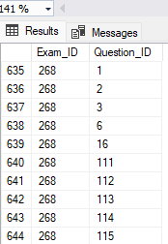
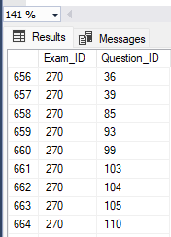
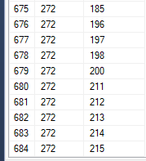
01.Exam Generation
Table Exam_Quest_Generation

Slide 28
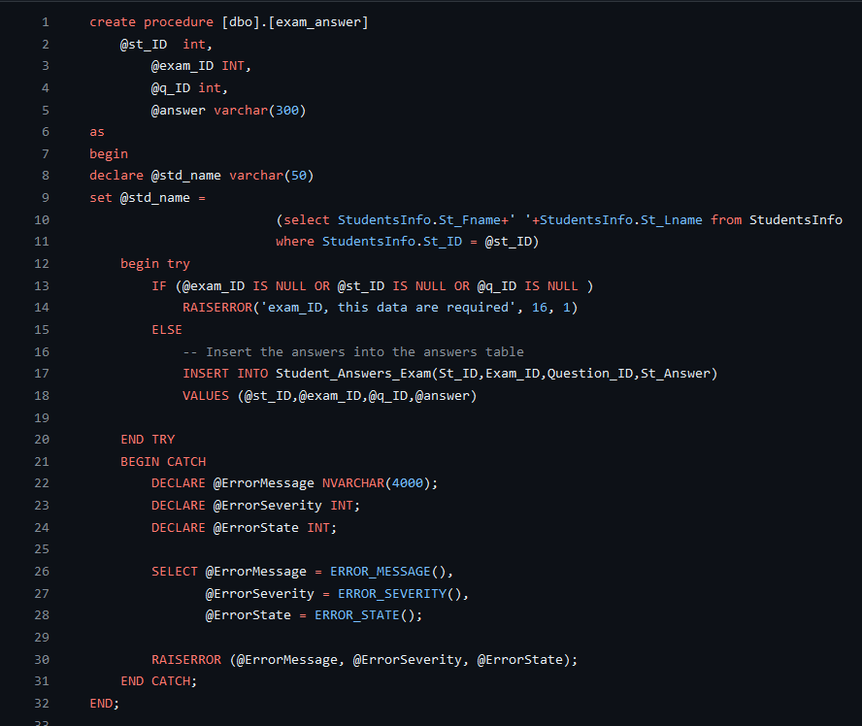
02.Exam Answer

Slide 29
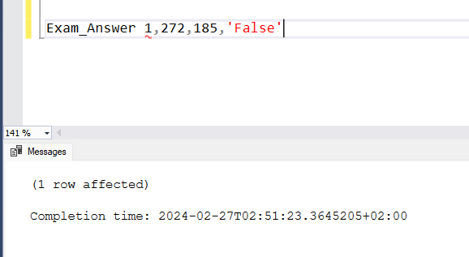
02.Exam Answer

Slide 30
02.Exam Answer
Table Student_Answers_Exam

Slide 31
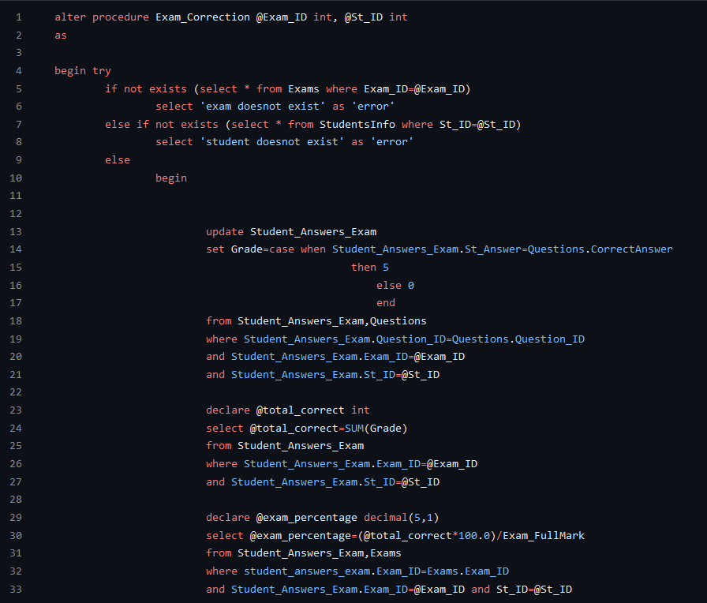
03.Exam Correction

Slide 32
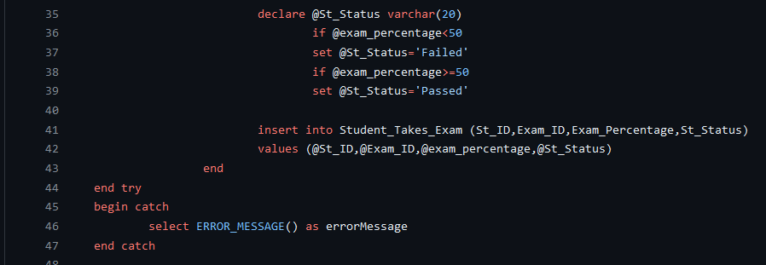
03.Exam Correction

Slide 33
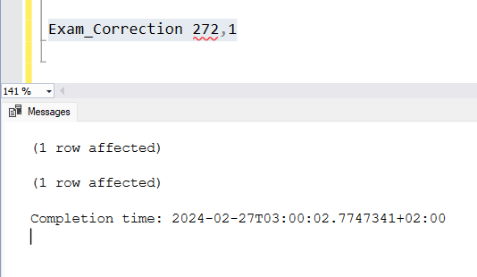
03.Exam Correction

Slide 34
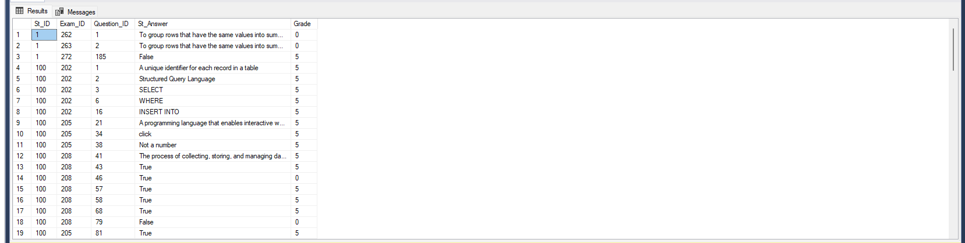
03.Exam Correction
Table Student_Answers_Exam

Slide 35
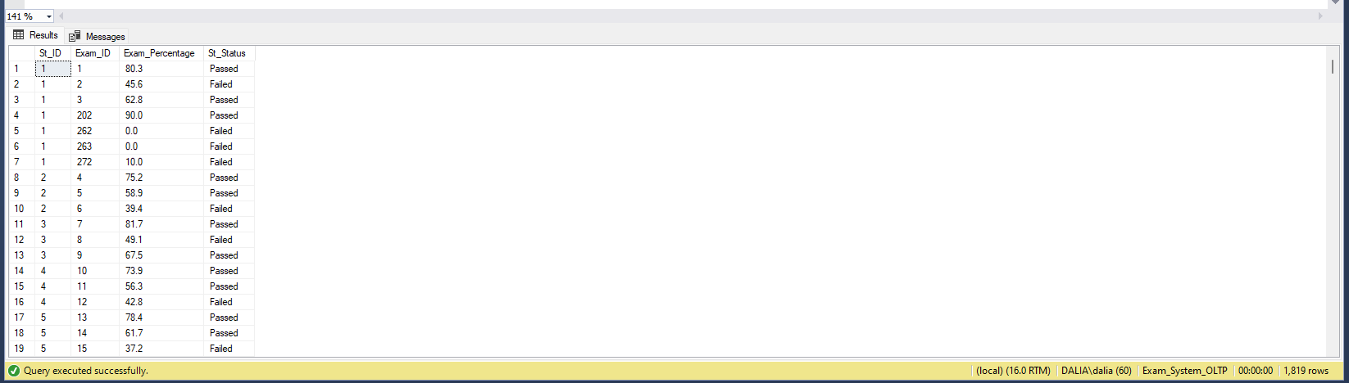
03.Exam Correction
Table Student_Takes_Exam

Slide 36
06.
Data Warehouse

Slide 37
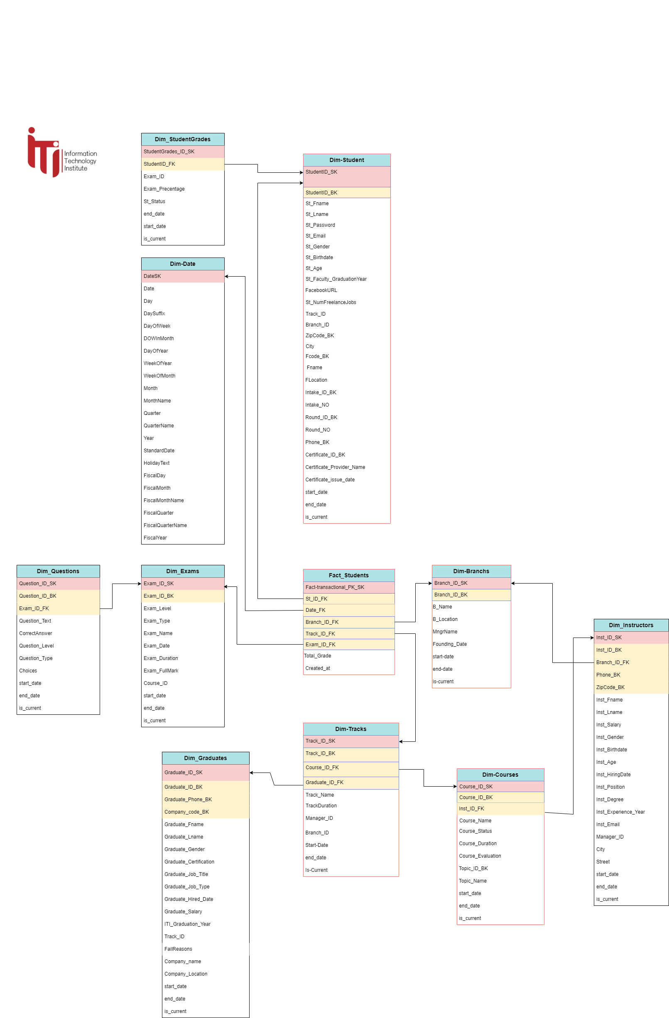

Slide 38
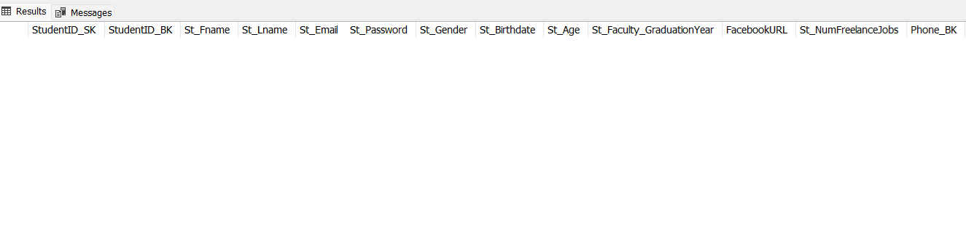
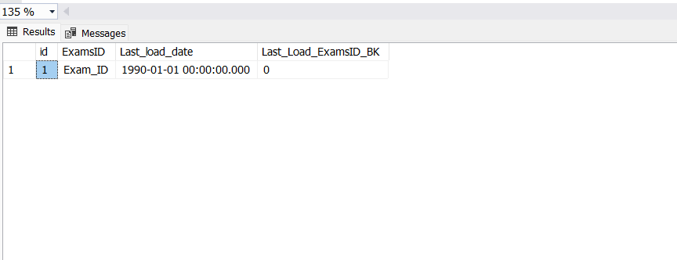
Data Warehouse

Slide 39
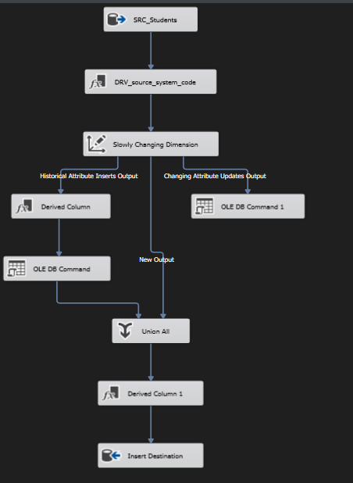
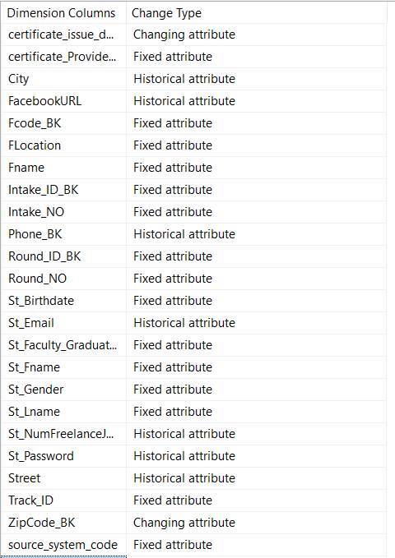
Data Warehouse

Slide 40
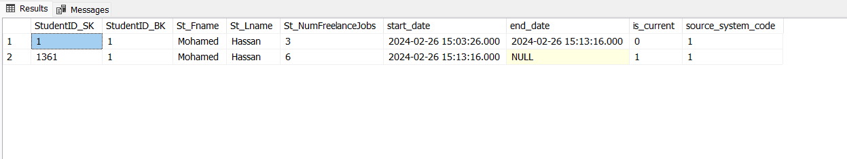
Data Warehouse

Slide 41
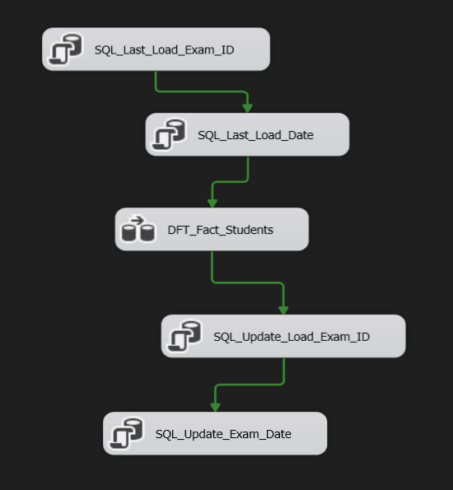
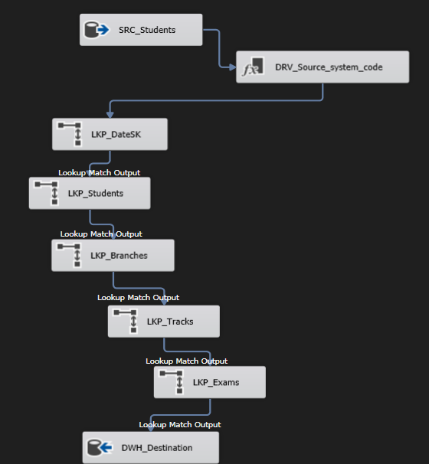
Data Warehouse

Slide 42
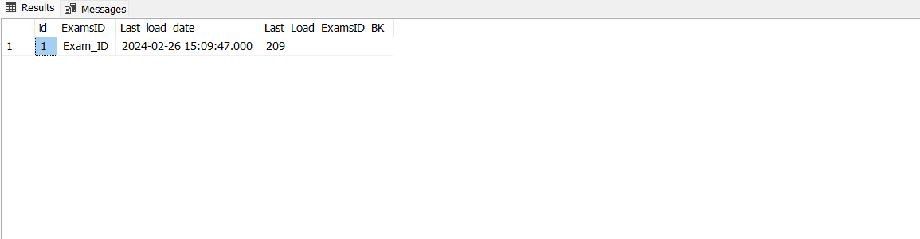
Data Warehouse

Slide 43
07.
SSRS Reports

Slide 44
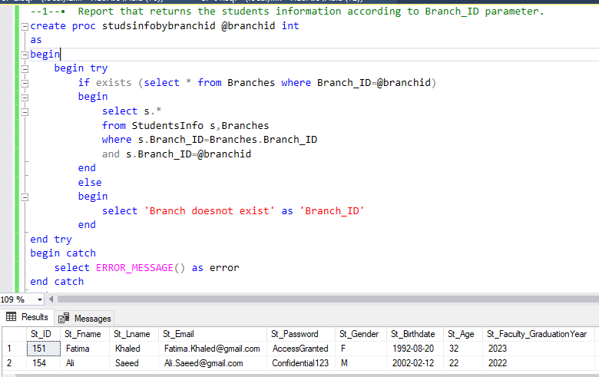
01. Student's info by Branch

Slide 45
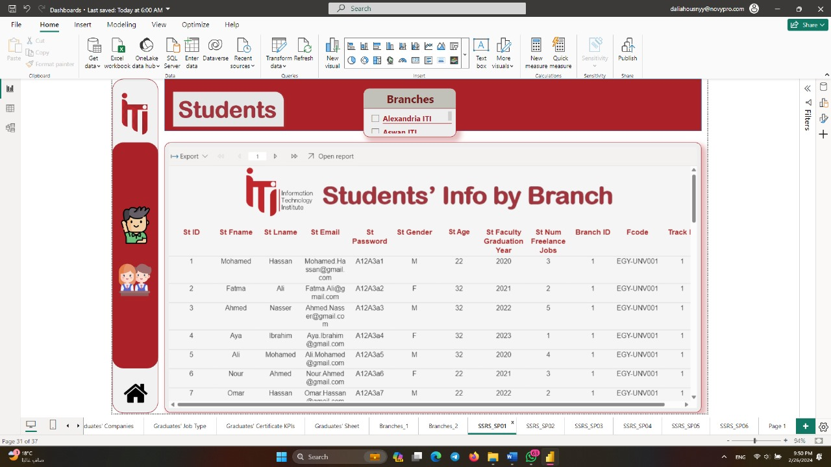
01. Student's info by Branch

Slide 46
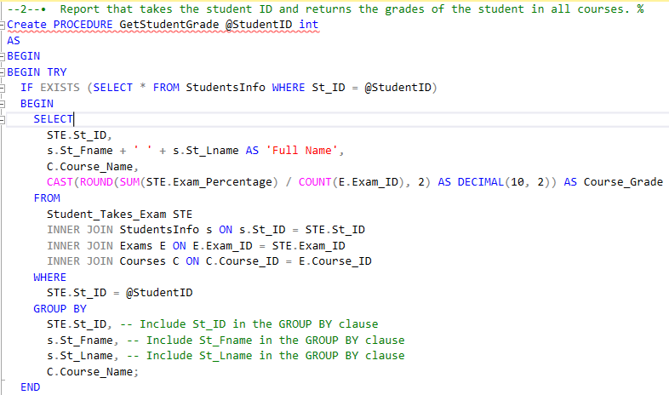
02. Student’s grade per course

Slide 47
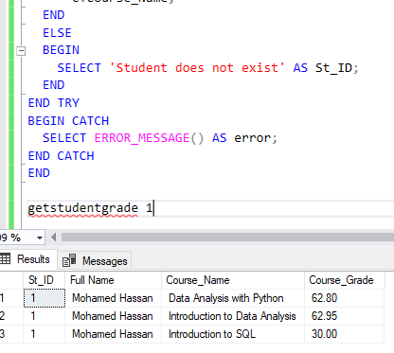
02. Student’s grade per course

Slide 48

02. Student’s grade per course

Slide 49
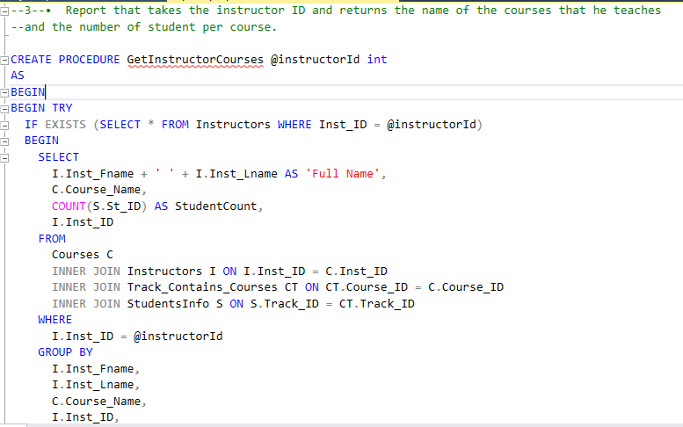
03. Courses by instructors

Slide 50
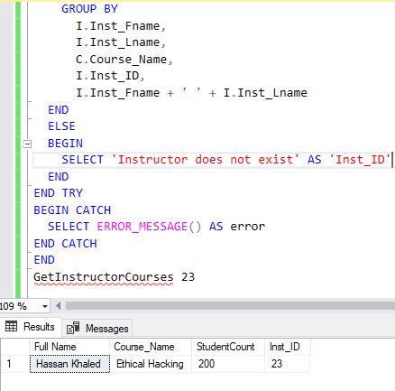
03. Courses by instructors

Slide 51
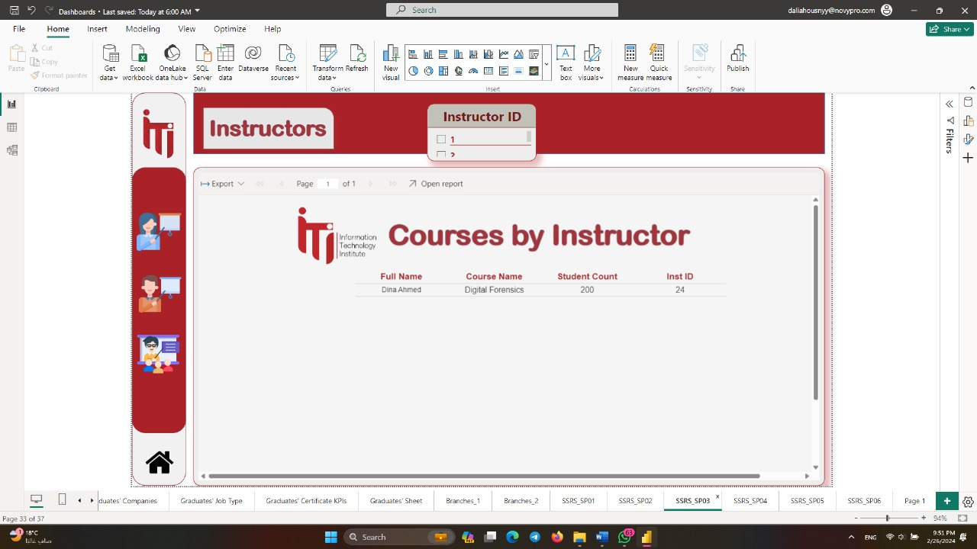
03. Courses by instructors

Slide 52
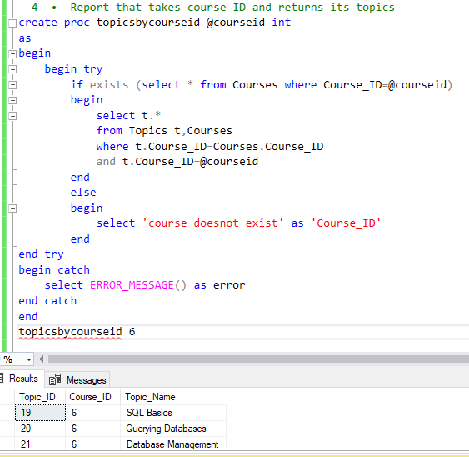
04. Topic per course

Slide 53

04. Topic per course

Slide 54
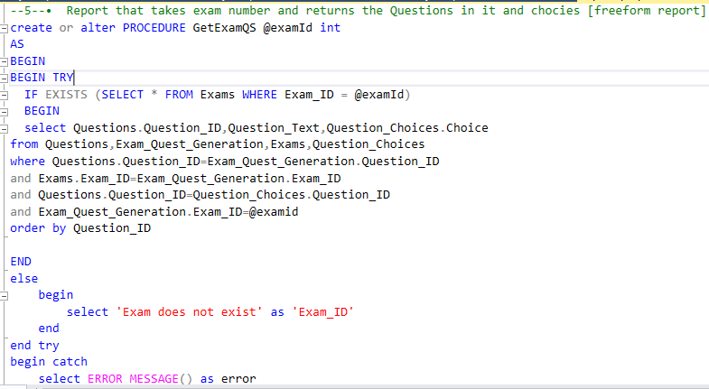
05. Questions per exam

Slide 55
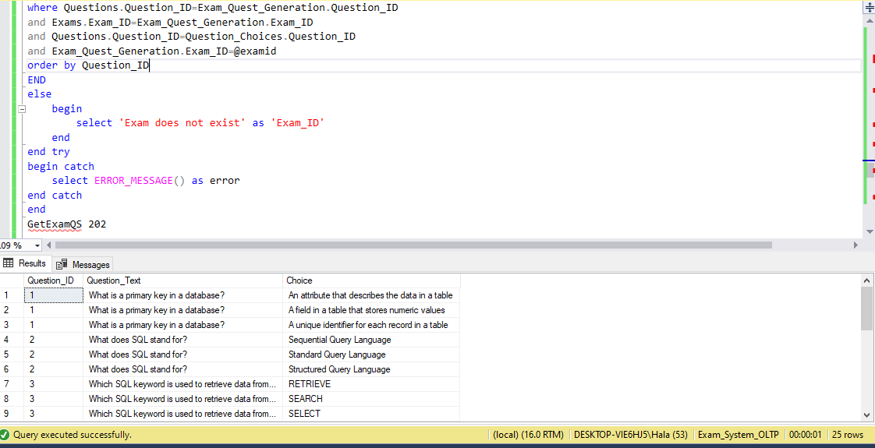
05. Questions per exam

Slide 56
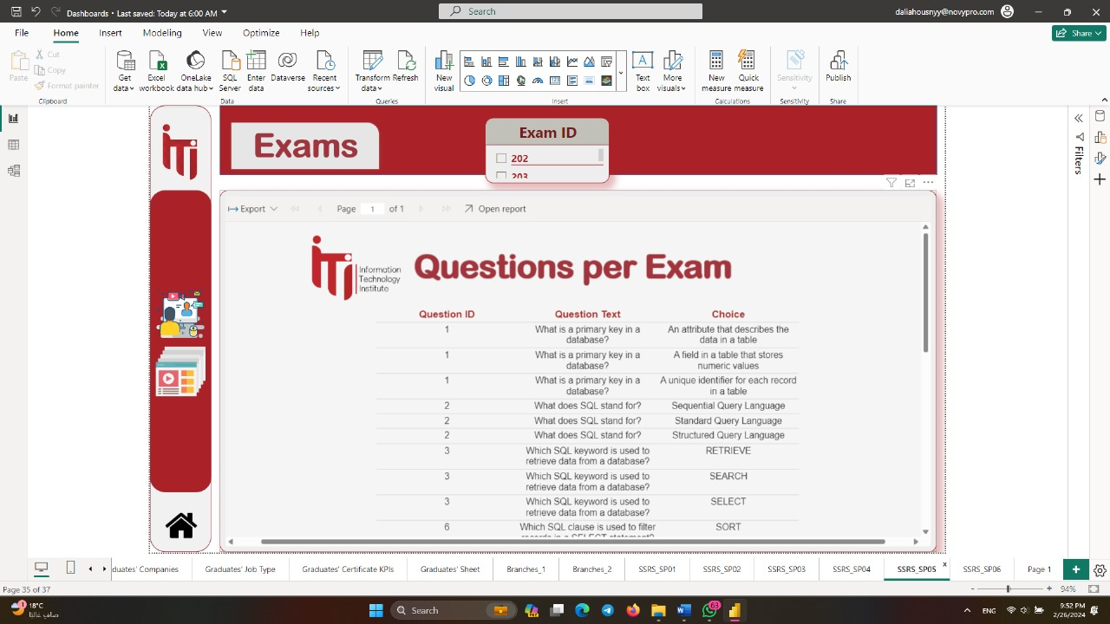
05. Questions per exam

Slide 57
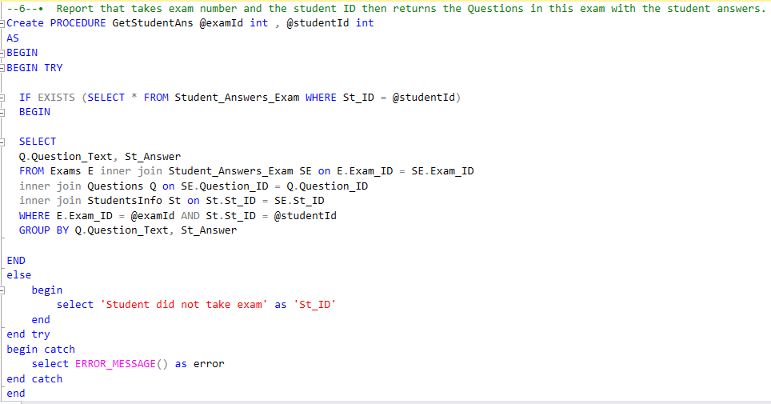
06. Student’s answers

Slide 58
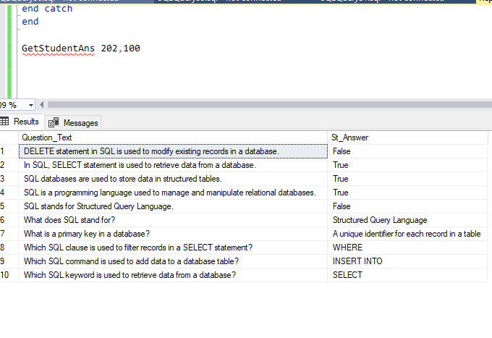
06. Student’s answers

Slide 59
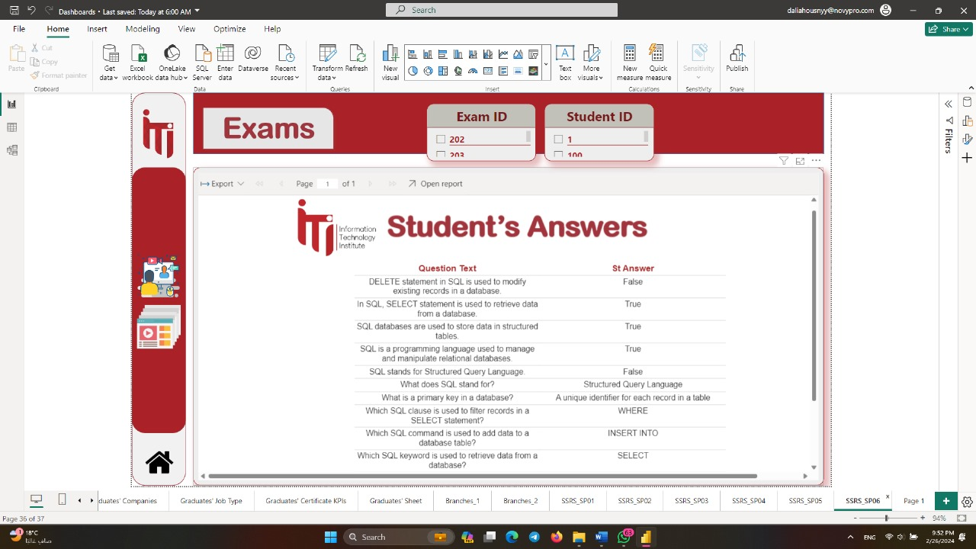
06. Student’s answers

Slide 60
Website
08.

Slide 61
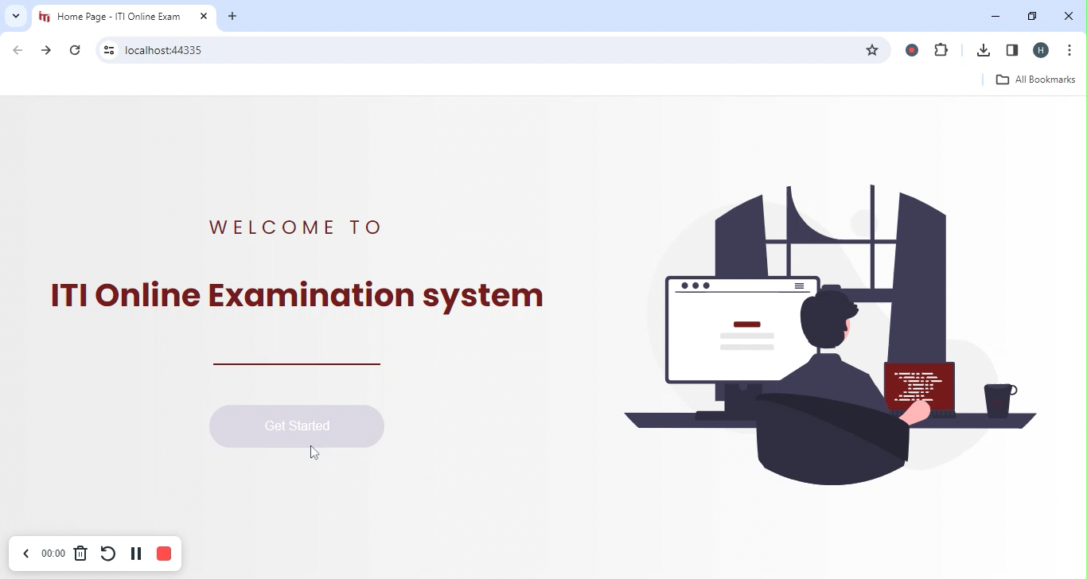
Notes:
Nada Hassan ST_ID=16 Exam id = 509 1- when answer all question 2- if answer half questions

Slide 62

01. First Exam Demo Results
Students Info Table

Slide 63

01. First Exam Demo Results
Exam Table

Slide 64

Exam Question Generation Table
01. First Exam Demo Results

Slide 65

Student Answer Exam Table
01. First Exam Demo Results

Slide 66

Student Take Exam Table
01. First Exam Demo Results

Slide 67

02. Second Exam Demo
Notes:
Youssef Ali ST_Id= 17 exam id = 511 Not Answer any question and time of exam ends

Slide 68

02. Second Exam Demo Results
Students Info Table

Slide 69

Exam Question Generation Table
02. Second Exam Demo Results

Slide 70

Student Answer Exam Table
02. Second Exam Demo Results

Slide 71

Student Take Exam Table
02. Second Exam Demo Results

Slide 72
Dashboards
09.

Slide 73


Slide 74


Slide 75


Slide 76


Slide 77


Slide 78


Slide 79


Slide 80


Slide 81


Slide 82


Slide 83


Slide 84


Slide 85


Slide 86


Slide 87


Slide 88


Slide 89


Slide 90


Slide 91


Slide 92


Slide 93


Slide 94


Slide 95


Slide 96


Slide 97


Slide 98


Slide 99


Slide 100


Slide 101


Slide 102


Slide 103


Slide 104
Conclusion
10.

Slide 105
Thank you Any Questions?

